Slide 1



Under the Hood: Analyzing Germany’s Used Car Trends
ZAHRA HUSAIN HUBAIL

Slide 2

Content
Introduction & Problem statement
Objectives
Data Overview
Price Analysis
Brand Analysis
Damage Rate
Recommendations
Limitations

Slide 3

Introduction
Problem Statement
As many buyers now turn to used cars for their affordability and variety, we analyzed eBay’s German used car market to uncover key trends. Our goal is to provide data-driven insights that help customers find the best-value vehicles by identifying fair prices, reliable brands, and durable options based on factors like age, condition, and fuel type.

Slide 4
This Analysis aims to:
Compare car prices by year, type, and condition.
Identify brands with extreme prices and damage rates.
Explore how mileage affects damage and price.
Analyze brand availability and their condition.
Assess listing speed and vehicle age trends.

Slide 5
Data Overview
Number of Vehicles Listed
246.58K
Number of Brands
39
Average Price (Euro)
6.76K
Average Mileage
23.85K
Average Vehicle Age (Years)
12.46
Damage Rate
0.10
Average Time Frame (Days)
9.25

Slide 6
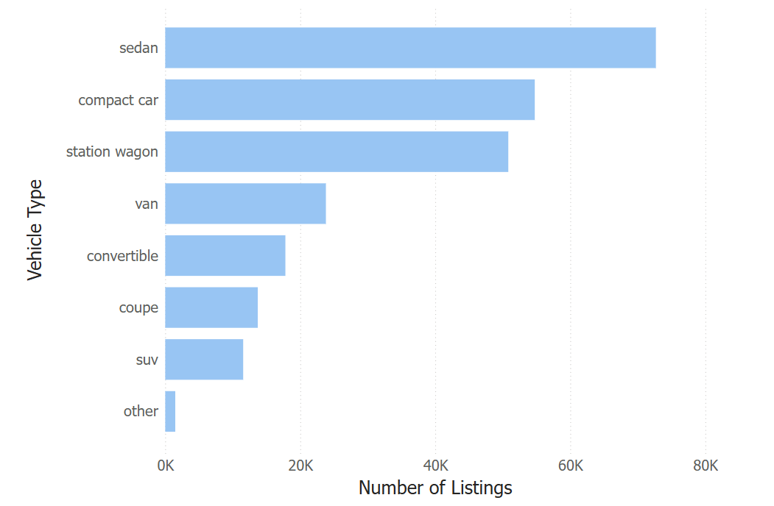
Vehicle Type Distribution

Slide 7
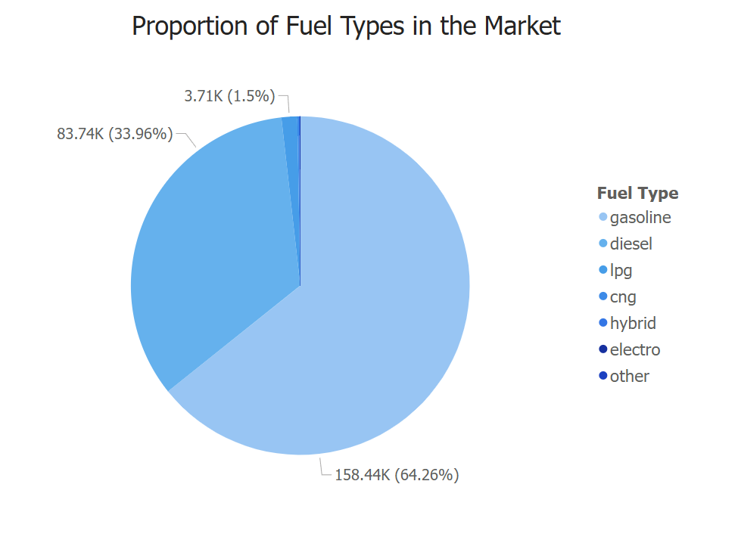
Fuel Types Distribution

Slide 8
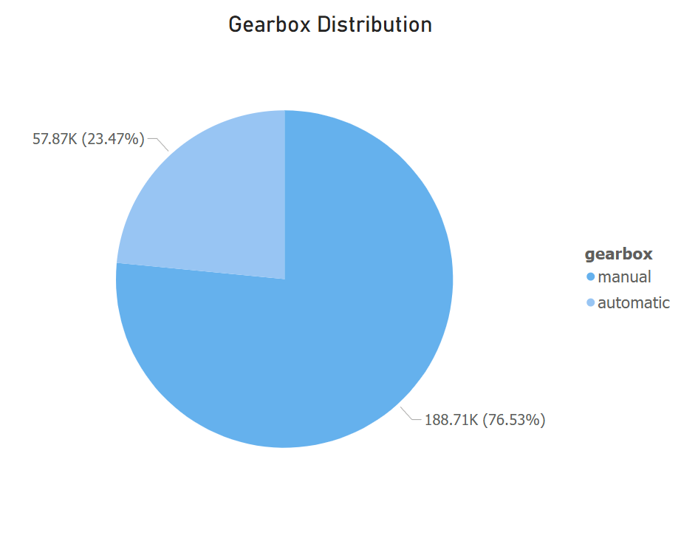
Gearbox Distribution

Slide 9
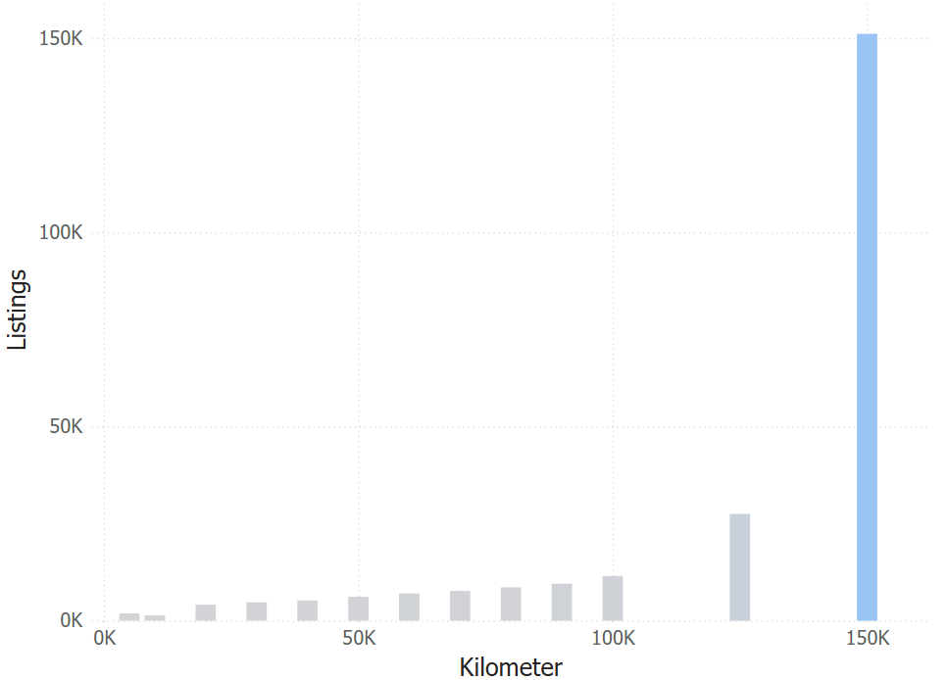
Mileage

Slide 10
Price Analysis

Slide 11
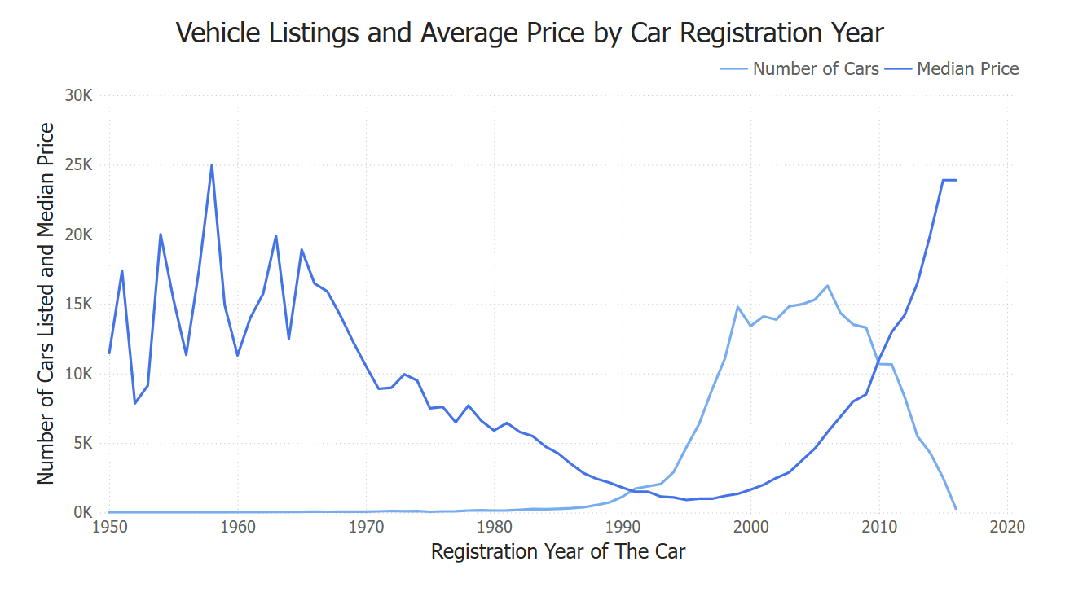
Number of Cars and Their Median Price By Car Registration Year (1950–2016)

Slide 12
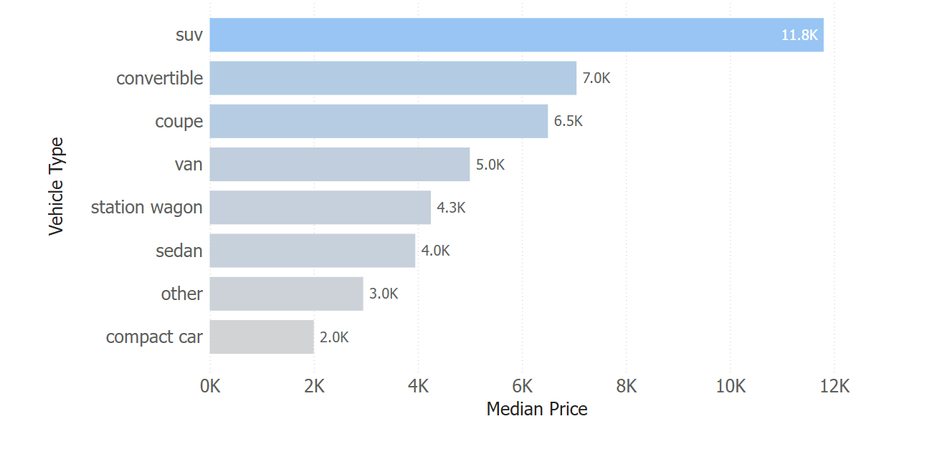
Median price by vehicle Type

Slide 13
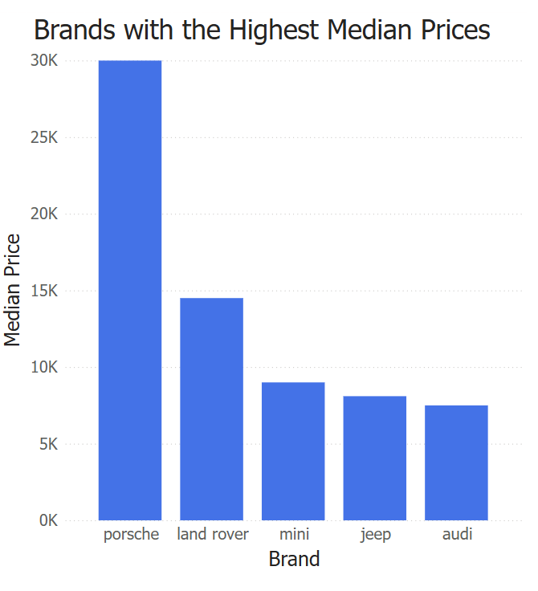
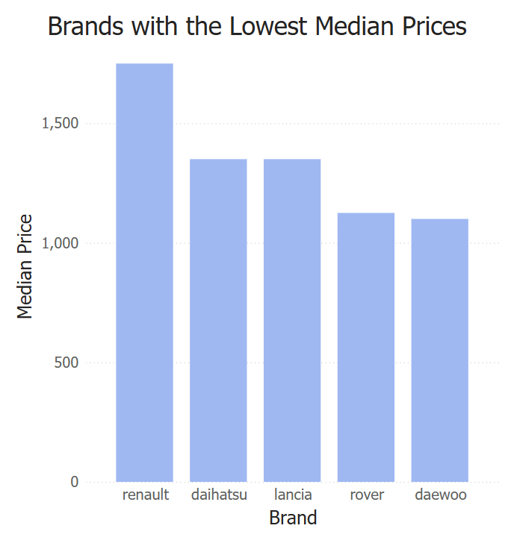
Brands with the Highest and Lowest Median Prices

Slide 14
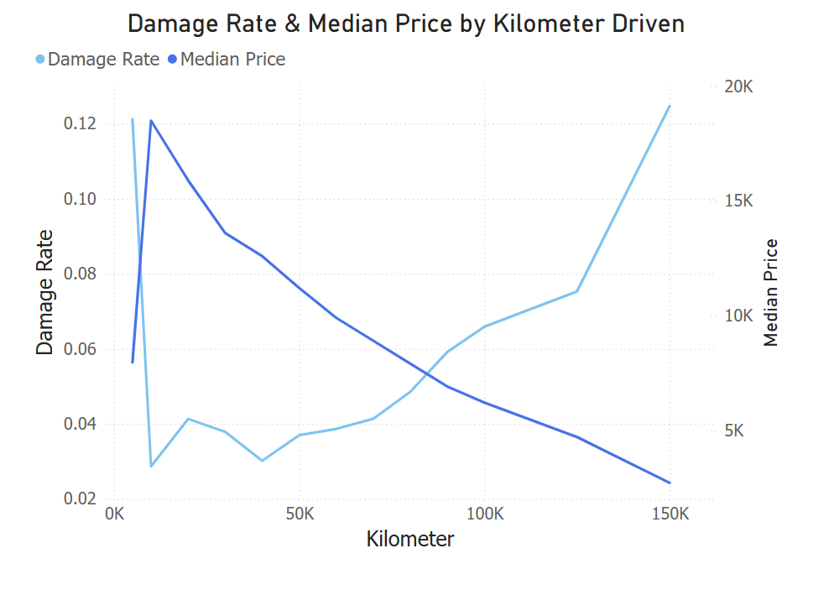
The Drop of Price

Slide 15
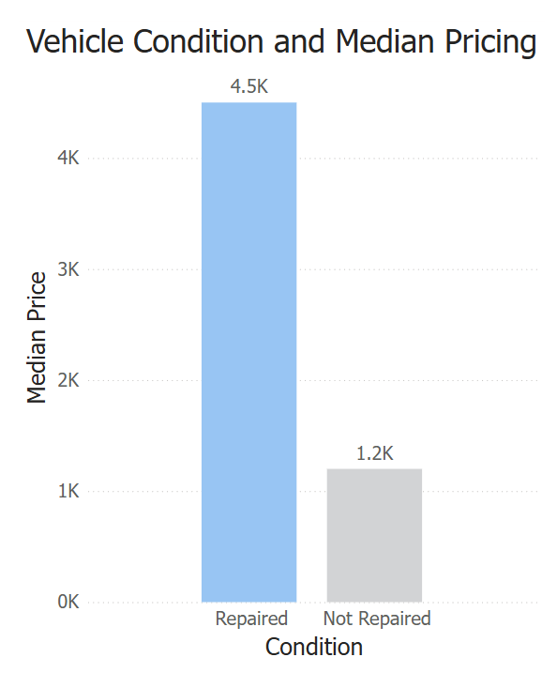
Median Price in Relation to the Condition

Slide 16
Brand Analysis

Slide 17
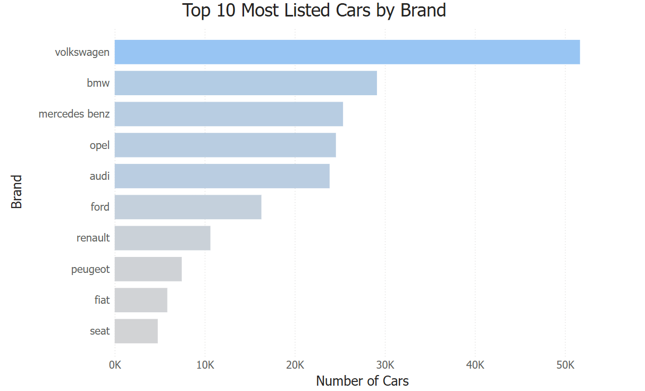
Brand Availability

Slide 18
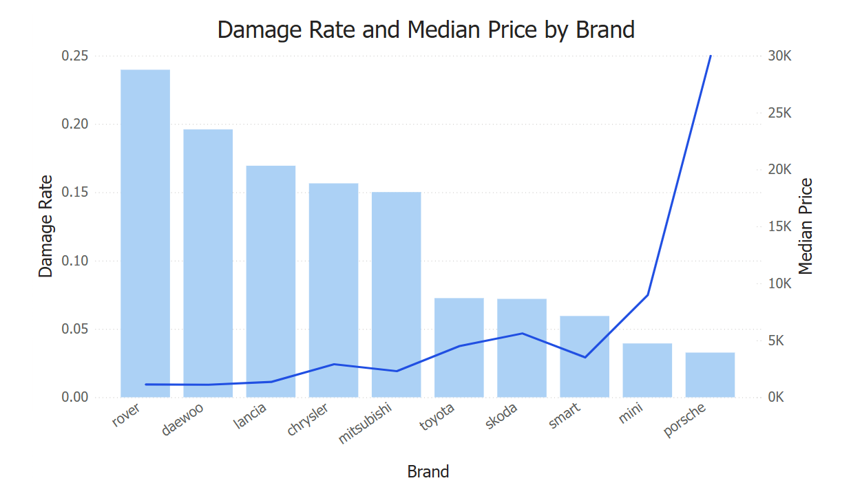
Vehicle Brands with the Highest and Lowest Damage Rates

Slide 19
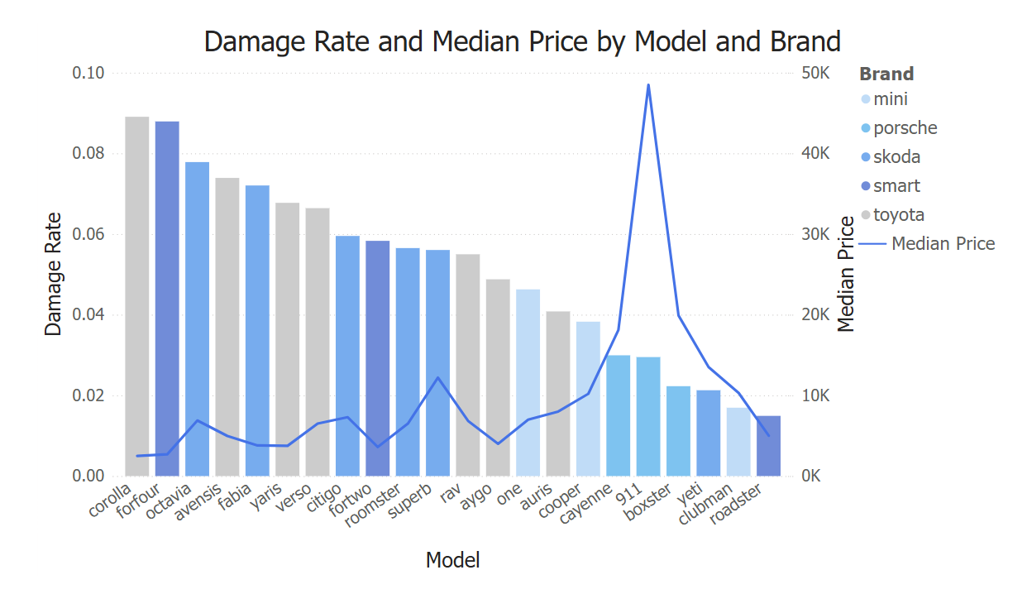
Lowest Damage Rate Brands and their available models

Slide 20
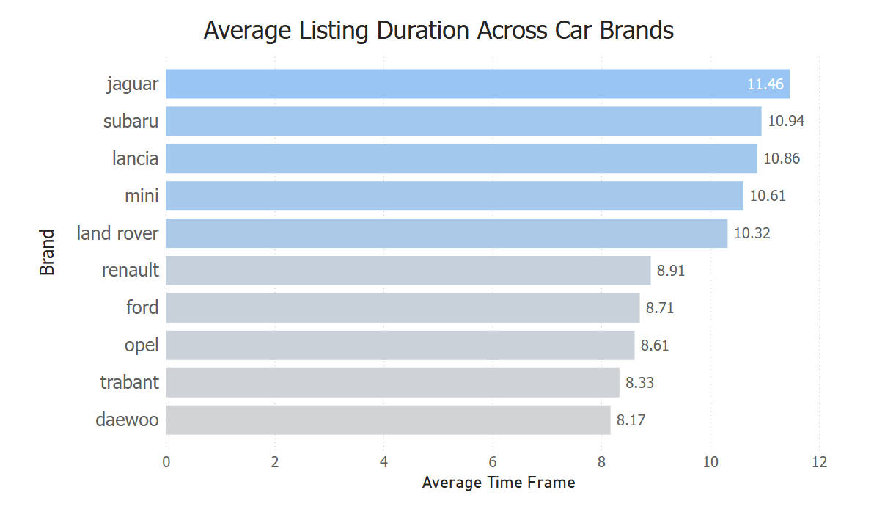
Time Between Listing and Last Seen for quickest and slowest brands

Slide 21
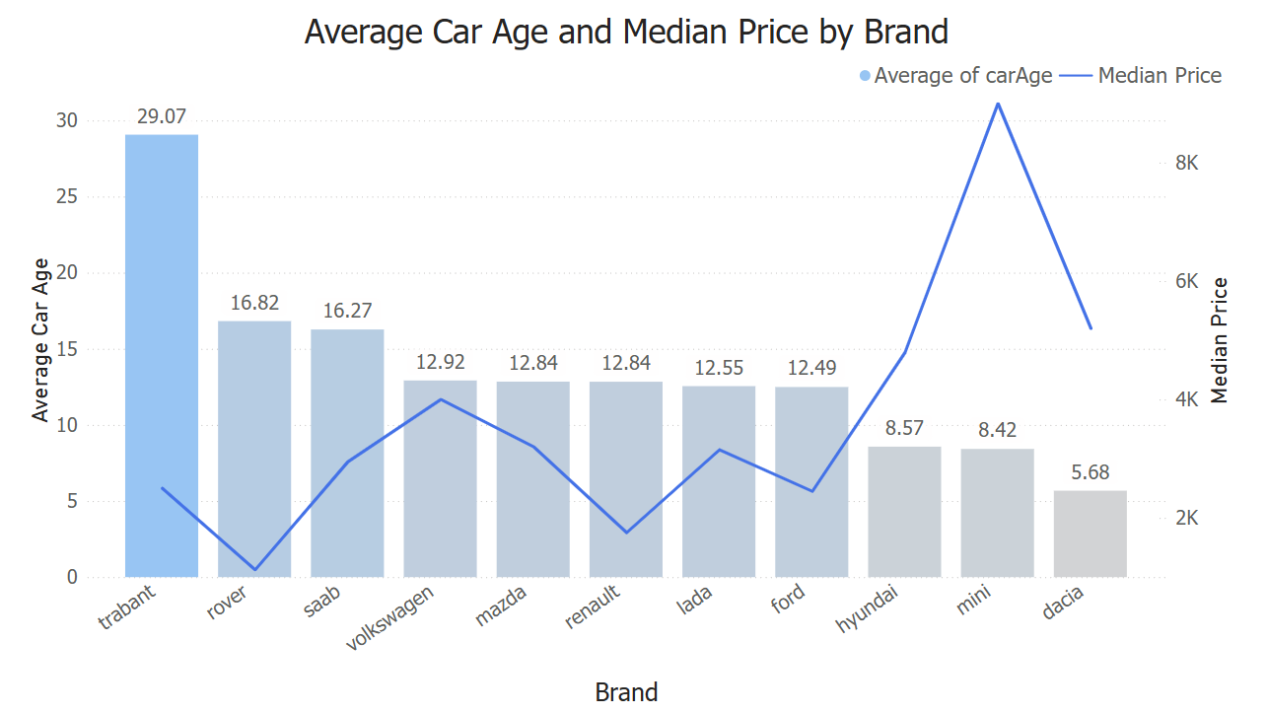
Average Vehicle Age Across Brands

Slide 22
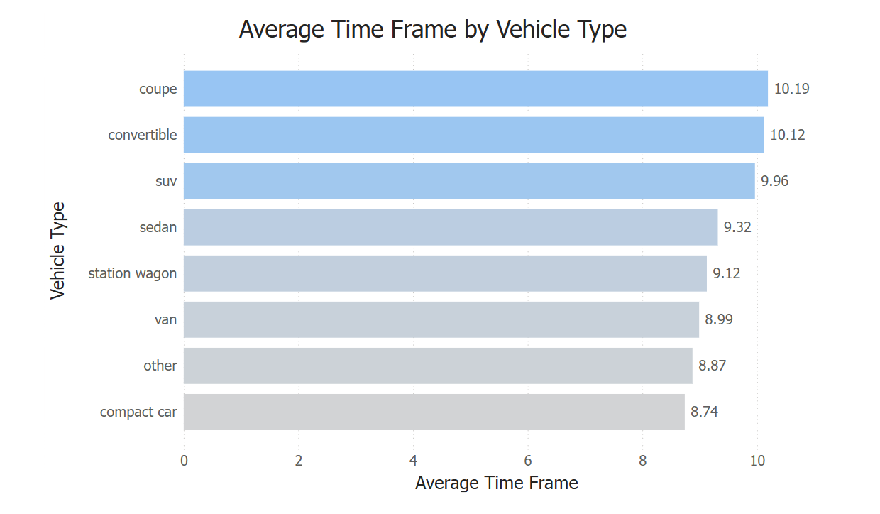
Average Time Frame Across Vehicle Types

Slide 23
Damage Rate

Slide 24
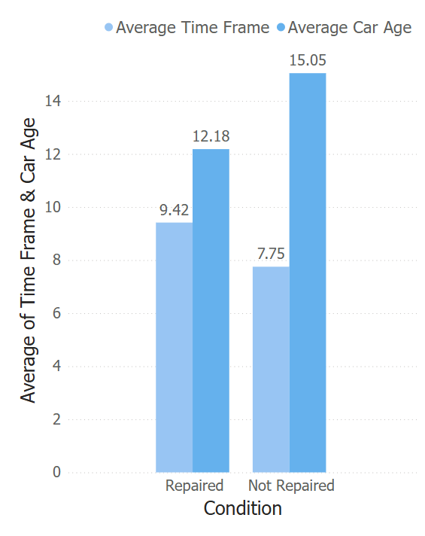
Average time frame and car age by condition

Slide 25
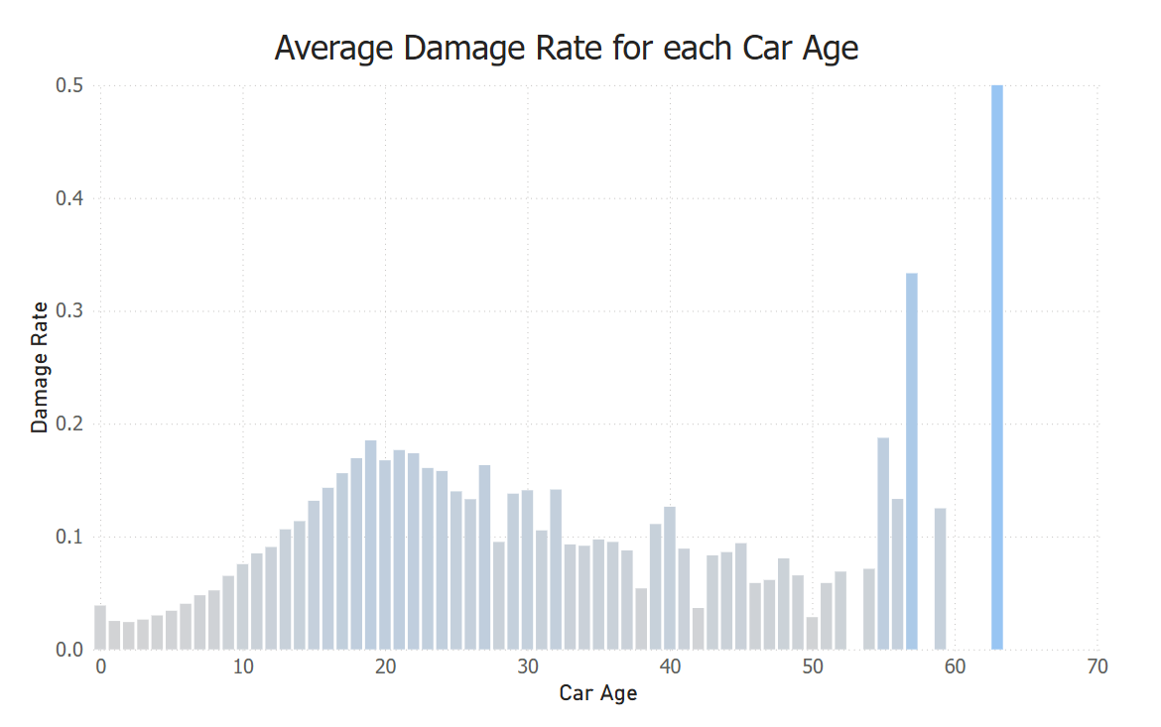
Damage Rate in Relation to Car Age

Slide 26
Recommendations
Avoid buying vehicles with mileage under 5,000 km.
higher listing counts typically corresponds to lower vehicle prices.
Choose Brands with lower damage rate and reasonable prices.
Avoid cars around 20 years old, as they are more likely to have damage.

Slide 27
Limitations
Accurate pricing needs localized, region-specific data.
Bahrain-specific data offers relevant insights for the local market.
Fields like date created and last Seen in the dataset are confusing for time-based analysis due to user-driven updates.
The time it took for data creation is limited to two months only.

Slide 28
Thank You

